Slide 1
Lecture 12
Two Applications in Diesel Engines
12.-1

Slide 2
Application 1:
Injection-Rate Shaping in Diesel Engine Combustion
The concept of flamelet equations and Representative Interactive Flamelets (RIF) prove valuable in the simulation of turbulent combustion in diesel engines.
Here, it is applied to study the effect of top-hat and boot-shaped injection-rate shapes on ignition, combustion, and pollutant formation as an advanced technology to achieve the stringent emission standards in the near future.
12.-2

Slide 3
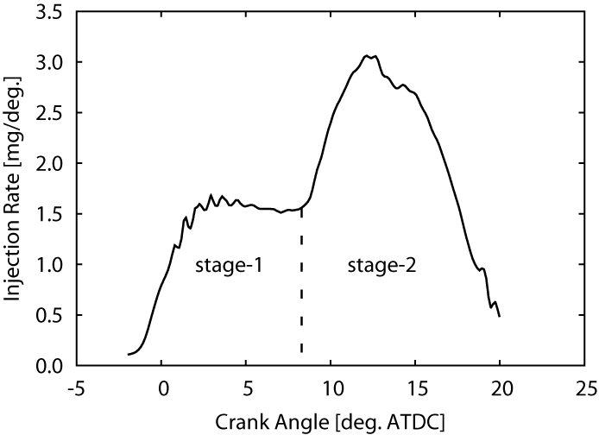
The boot-shaped rate comprises two different stages of injection,
The dashed-line on the figure
marks the separation
between the two stages.
In the first stage, fuel injection
starts and the injection rate
increases to its first peak
and remains nearly constant
until the beginning of the
second stage.
12.-3

Slide 4
In the second stage, the injection rate further increases from the first peak to the second peak, and then decreases till the end of injection time.
The peak injection-rate
(referred to as height)
in both stages of the boot
injection-rate shape is the
parameter of variation in
this study.
12.-4

Slide 5
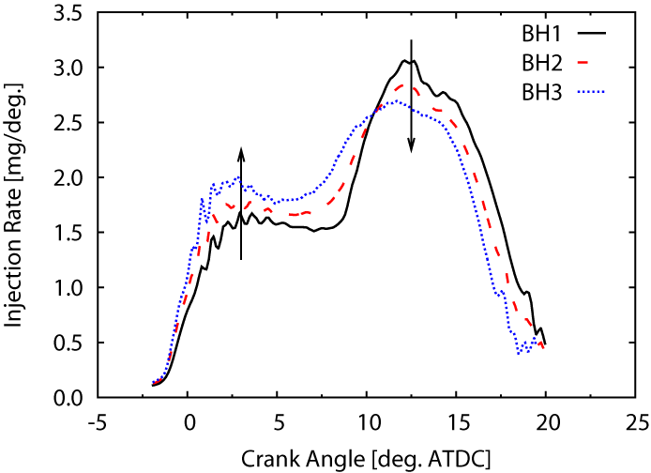
Owing to a constant total injected mass and spray momentum (and nearly constant overall injection duration), three different boot-shaped rates.
The figure shows the injection rate
(in mg per degree CA) of the
investigated boot-shaped rates
over crank angle.
The increase in the injection
rates of the first stage meant
the decrease in the injection
rates of the second stage of a
rate shape.
12.-5

Slide 6
The rate shapes are named as BH1, BH2, and BH3 according to their peak injection-rate (height) in the first stage.
Test case BH1 has the lowest
peak injection-rate in the
first stage and the highest peak
injection-rate in the second stage
among all.
Whereas, BH3 has the highest
peak injection-rate in the first stage
and the lowest peak injection-rate
in the second stage, respectively.
Test case BH2 is in the middle of BH1 and BH3.
12.-6

Slide 7
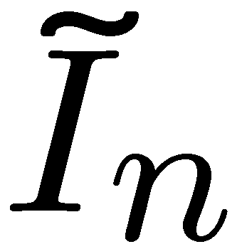
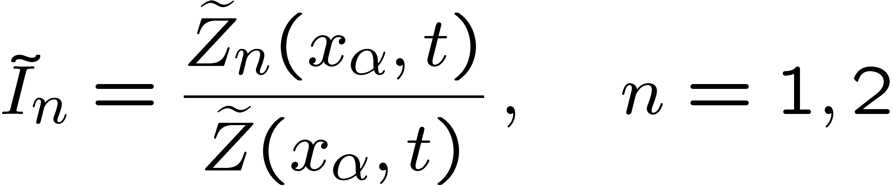
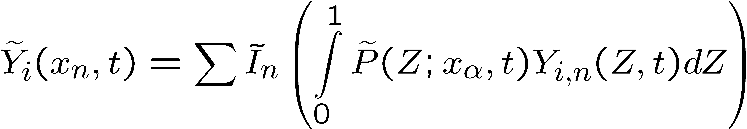
Simulations were performed using the multiple-flamelet (M-RIF) model for all the rate shapes.
The contribution of each flamelet in the same computational cell , is calculated from the ratio of its mean mixture fraction and the total value of mixture fraction in the cell.
Turbulent mean values of these scalars are then obtained by using the pre-assumed shape PDF in each cell:
12.-7

Slide 8
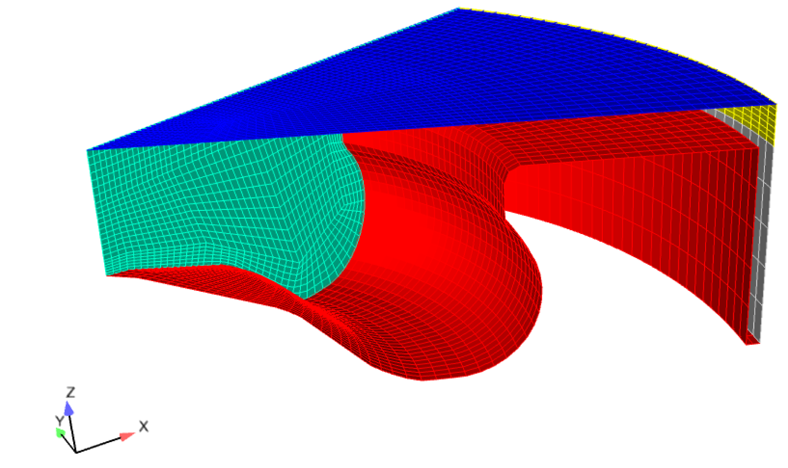
The surrogate fuel (IDEA) of diesel used in this work is a mixture of 70 % n-decane and 30 % α-methylnaphtalene (liquid volume).
Single-cylinder engine, computational grid at top dead center
12.-8

Slide 9
For the CFD simulation, a sector mesh representing 1/7th of the combustion was used by taking advantage of the circumferential symmetry of the centrally located injector equipped with a 7-hole nozzle.
12.-9

Slide 10
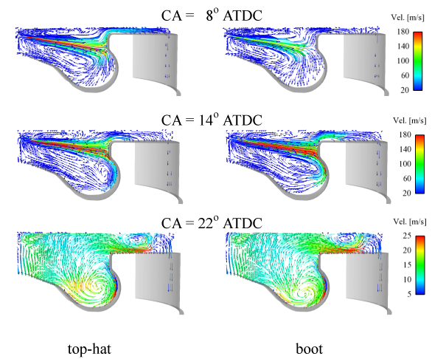
Details of the flow and mixing field are shown on a vertical center plane cut through the engine.
12.-10

Slide 11
The entrainment vortices generated by the spray plume can be clearly observed from the velocity field at 8 ºCA ATDC for both rate-shapes.
The piston is traveling down and a strong squish flow is directed into the squish volume (reverse squish) from the piston bowl in both cases of top-hat and boot-shape injection profiles, respectively.
At this crank angle, about 39 % of the total fuel has been injected in the top-hat compared to about 32 % of the total fuel in the boot case.
As a result, the top-hat case has a higher spray center-line velocity.
12.-11

Slide 12
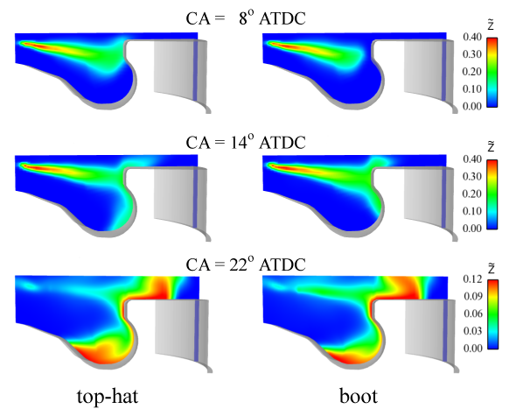
Spatial distributions of the mean mixture fraction
12.-12

Slide 13
In the top-hat, the initial mixing was superior due to the higher velocities (and spray momentum) and hence the vortex has moved deeper inside the bowl and the leading edges of the spray plume are better mixed and leaner compared to the boot case at this crank angle.
12.-13

Slide 14
Thus, in the beginning, the fuel has entered the cylinder with much higher injection velocities in the top-hat, and for the boot shape it happened in the latter crank angles.
A higher transport of fuel for a lower increment in the squish volume results in the richer fuel mixtures in the squish region for the boot case.
At 22 ºCA ATDC, a comparison of the mixing field for both shapes shows that the fuel distribution is better for the boot shape allowing the higher mixing with the surrounding air.
12.-14

Slide 15
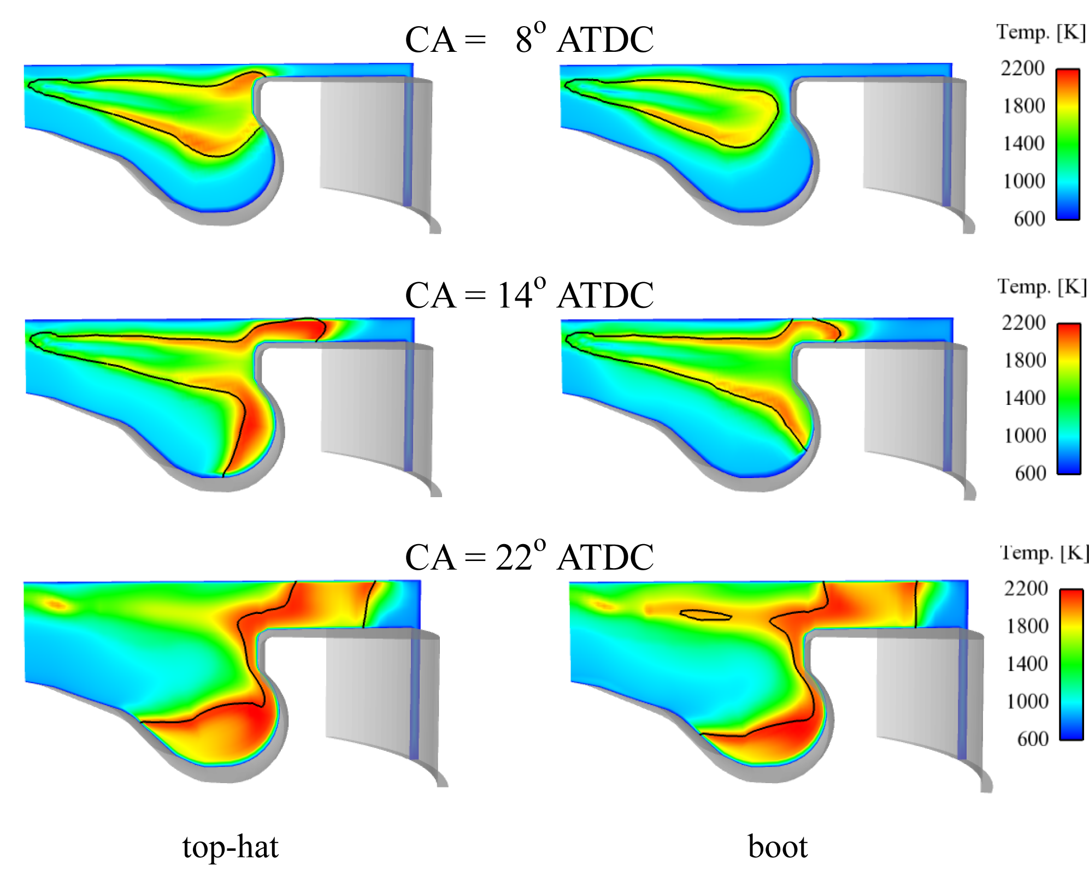
The discussed injection, mixing, and evaporation characteristics are also reflected in the temperature fields for top-hat and boot shape injection profiles.
12.-15

Slide 16
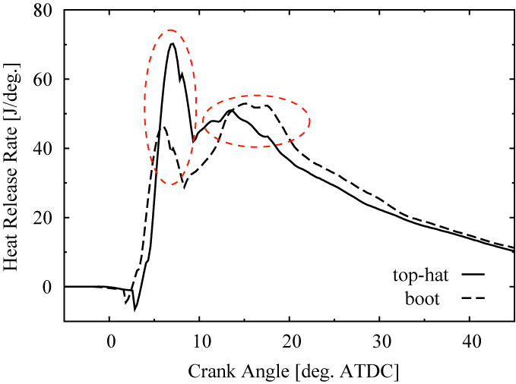
Computed heat release rates for both injection-rate shapes.
The effect of evaporation is
evident in the heat release
for both shapes.
Earlier start of evaporation
in the boot shape shows also
early rise in the
heat release rates.
The top-hat shape shows the
highest premixed peak in heat release rate due to higher evaporation rates during that period. Higher evaporation rates after 10 ºCA ATDC in the boot shape results in the highest peak during diffusion-controlled combustion.
12.-16

Slide 17
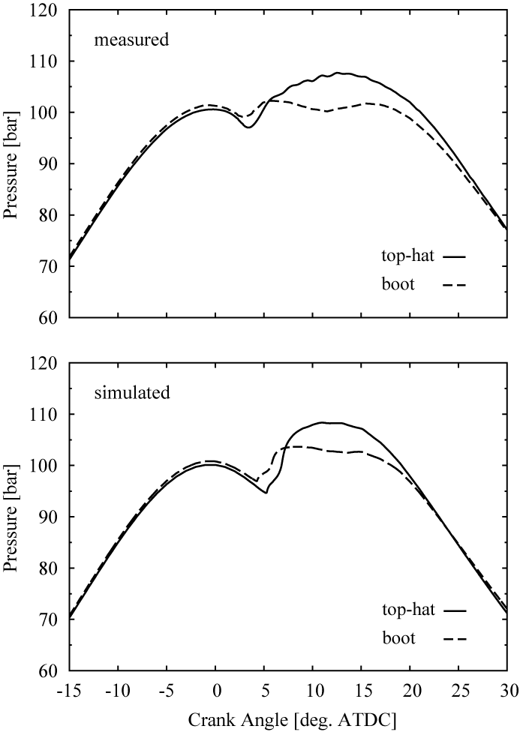
Comparison of the simulated and
measured pressures for both shapes.
The measured and computed
pressure evolutions show the
same trends and good agreement.
The model predicts an earlier
ignition in the boot case as also
seen in the experiments.
This trend could be associated
with the early start of injection and fuel evaporation leading to early molecular level mixing for the boot case.
12.-17

Slide 18
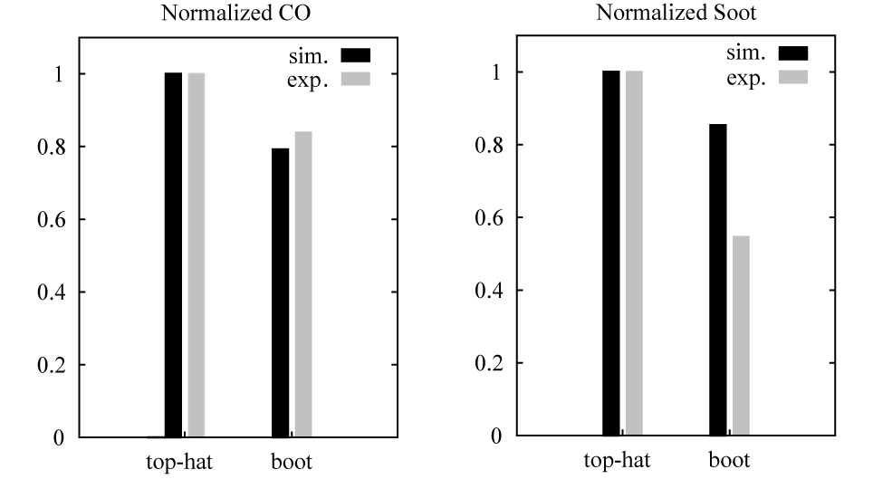
Comparison of the simulated and measured soot (top) and CO (below) emissions at exhaust valve opening (EVO).
The indicated concentrations are scaled to one in the top-hat case.
Similar to the experiments, the model predicts a significant reduction in both soot and CO emissions at EVO for the boot shape.
12.-18

Slide 19
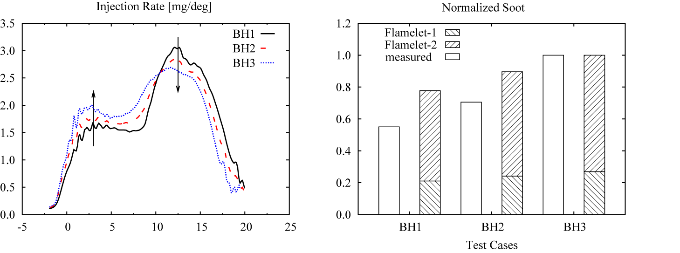
Compared normalized soot values (scaled to 1.0) at exhaust valve opening in the experiments and simulations.
In the experiments, lowering the injection rates in the first stage (i.e. increasing the rates in the second stage) total in-cylinder soot decreased at exhaust valve opening. This trend is satisfactorily captured in the simulations, though the level of reduction, with increasing injection rates in the first stage, is lower.
12.-19

Slide 20
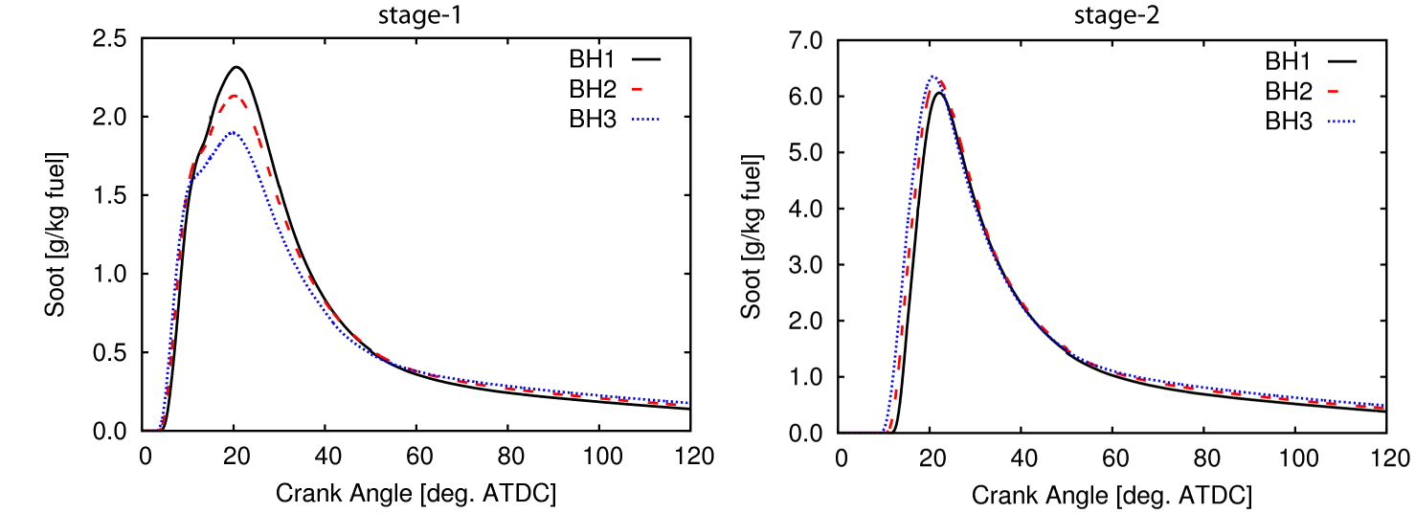
History of soot formation for the mass belonging to the first stage.
BH3 has the lowest, and BH1 has the highest peak soot formation.
One can conclude that the higher injection rates in the first stage results in a lower peak in soot formation.
12.-20

Slide 21
However, at exhaust valve opening BH3 predicted higher soot emissions among all test cases.
12.-21

Slide 22
The rate shape corresponding to BH1 shows the improved soot oxidation among the rate shapes.
12.-22

Slide 23
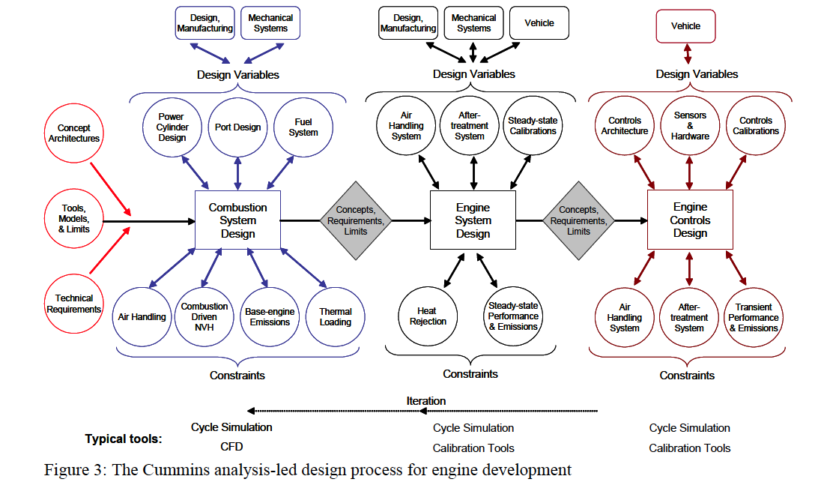
Application 2:
Analysis-Led Design Process for Cummins Engine Development
W.A. Eckerle¹ and D.W. Stanton², Thiesel 2006, Valencia
12.-23

Slide 24
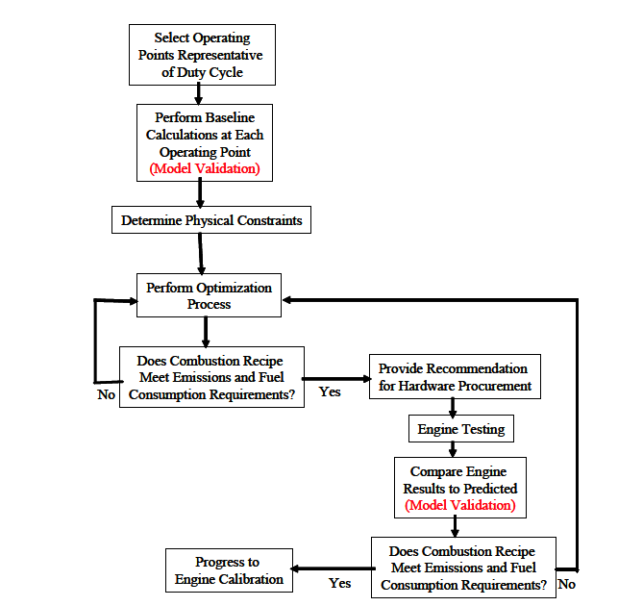
Combustion system design process
12.-24

Slide 25
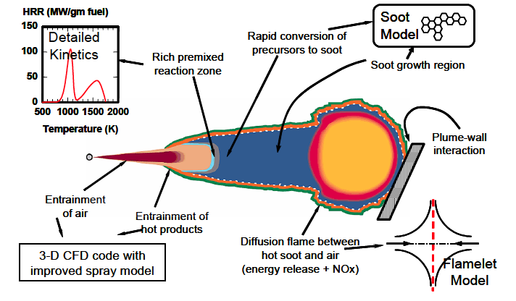
The physical processes of diesel combustion modeled using the KIVA3 code
with the Representative Interactive Flamelet modeling approach
12.-25

Slide 26
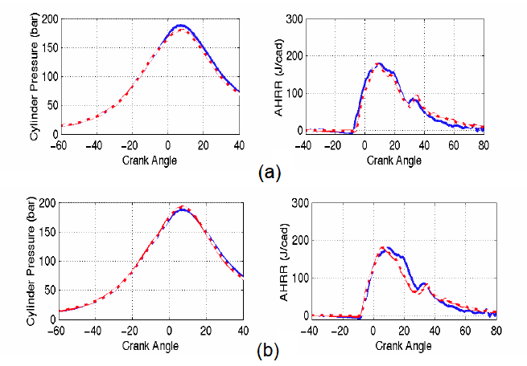
Cylinder pressure and heat release for two different cases
12.-26

Slide 27
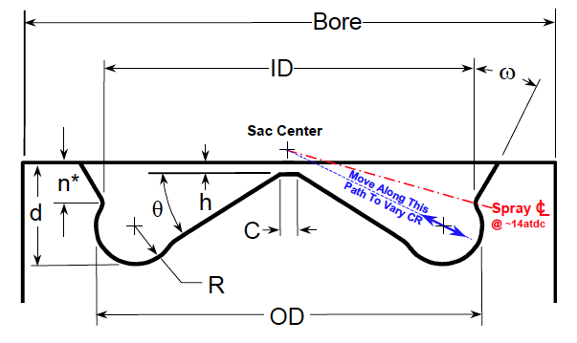
Piston bowl parameters used in the optimization process
12.-27

Slide 28
Piston bowl parameters used in the optimization process
12.-28

Slide 29
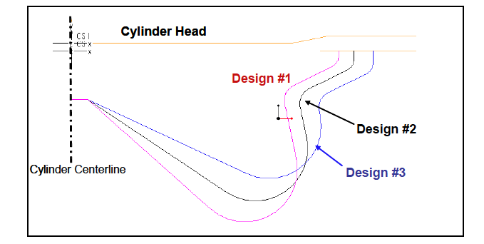
A subset of piston bowl profiles analyzed
during the combustion system optimization
12.-29

Slide 30
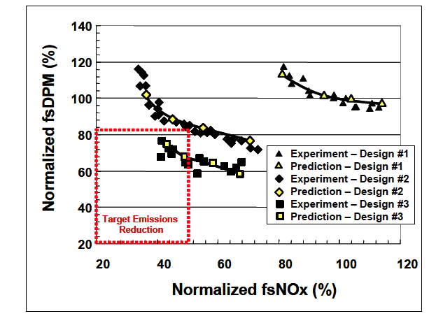
12.-30

Slide 31
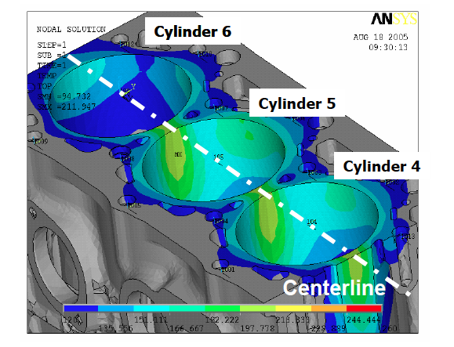
12.-31

Slide 32
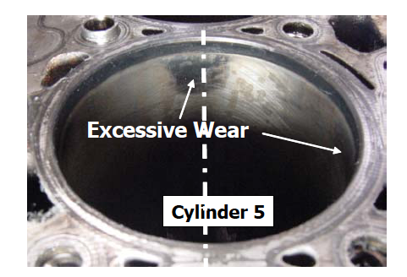
12.-32

Slide 33
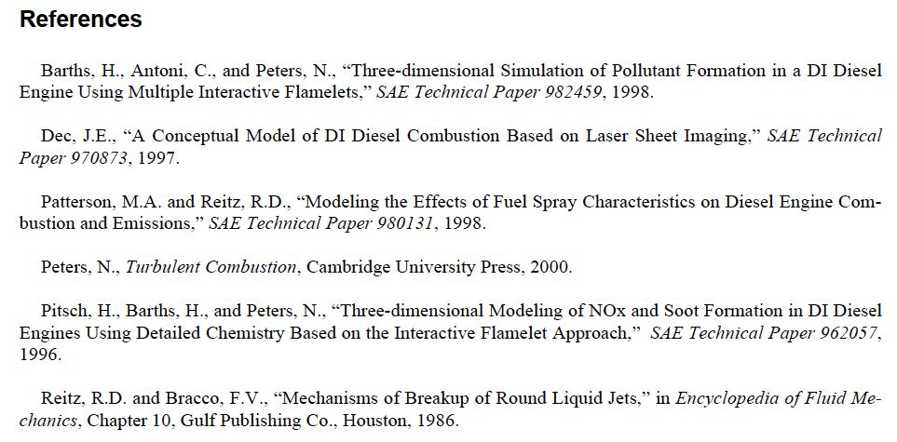
12.-33

